Slide 1
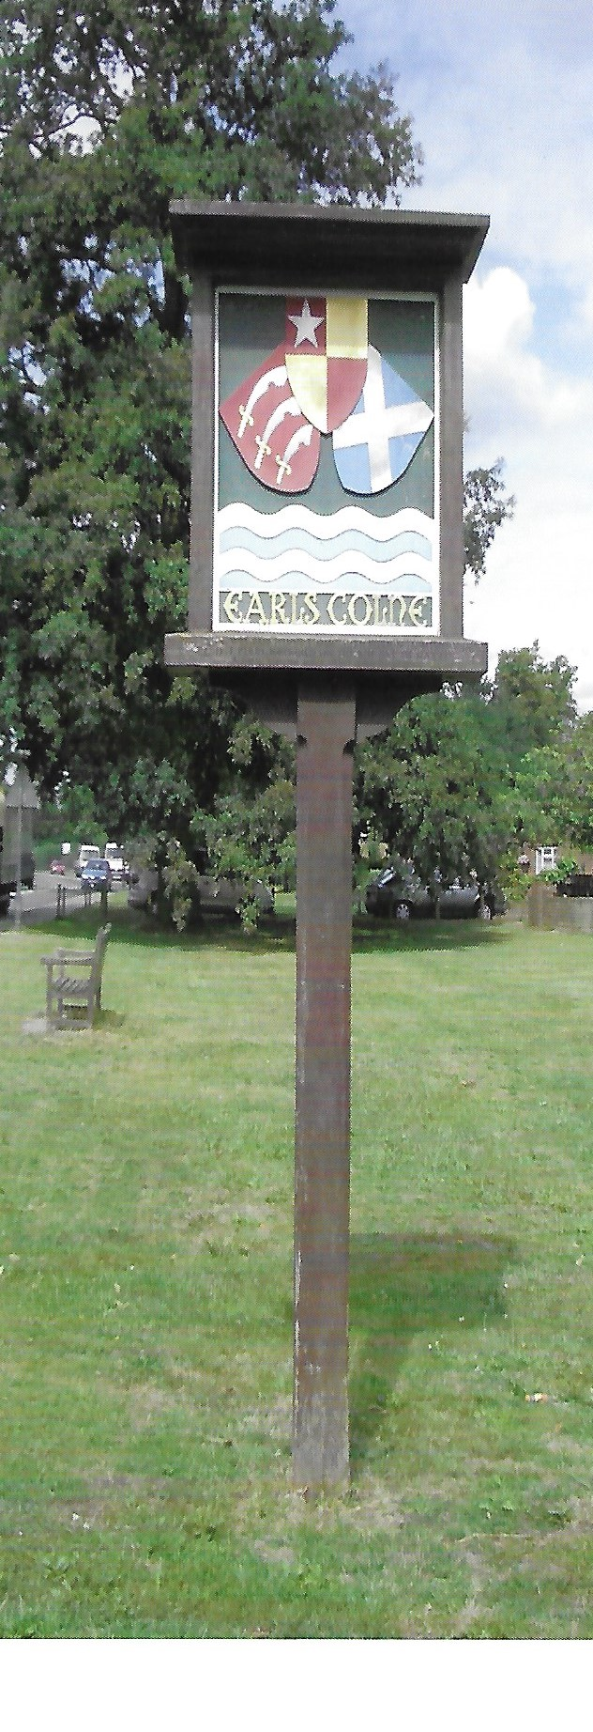

Earls Colne Neighbourhood Plan
Update 20.02.19

Slide 2
Activities since Last Parish Council Meeting
Initial meeting of Steering Group held on 5th February with all members attending
Draft “Terms of Reference” for Steering Group prepared for Council approval
Formal application to Braintree District Council prepared including parish Map
First draft of NP project programme prepared
Joint meeting for Task Groups Planned for 26th February to confirm volunteers for each group.

Slide 3
Organisation
Parish Council Neighbourhood Plan Sub Committee
Tony Calton
Hugh Street
Margaret Barratt
Nikki Spelling
Neighbourhood Plan Steering Group
Tony Calton Paul Copsey
Robert Cook Nikki Spelling
Sheila Boyce Margaret Barratt
Denis Siddall Catherine Hayes
Hugh Street
Task Group
Housing
Leader: Paul Copsey
Task Group
Environment
Leader: Catherine Hayes
Task Group
Economy
Leader: Denise Siddall
Task Group
Community Facilities
Leader: Nikki Spelling
Task Group
Infrastructure
Leader: Robert Cook

Slide 4
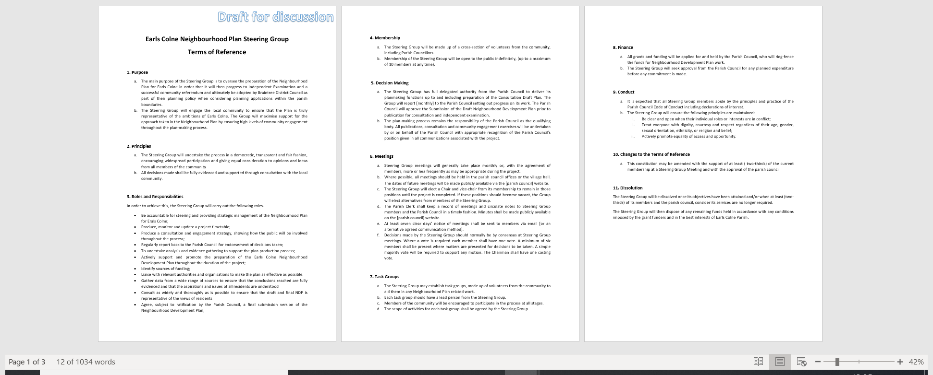
Steering Group –Terms of Reference

Slide 5
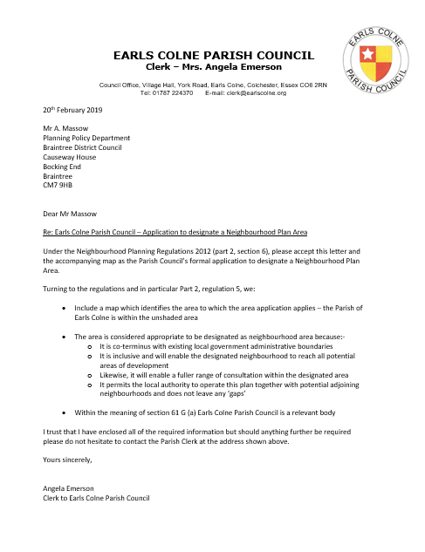
Formal application to Commence Neighbourhood Plan

Slide 6
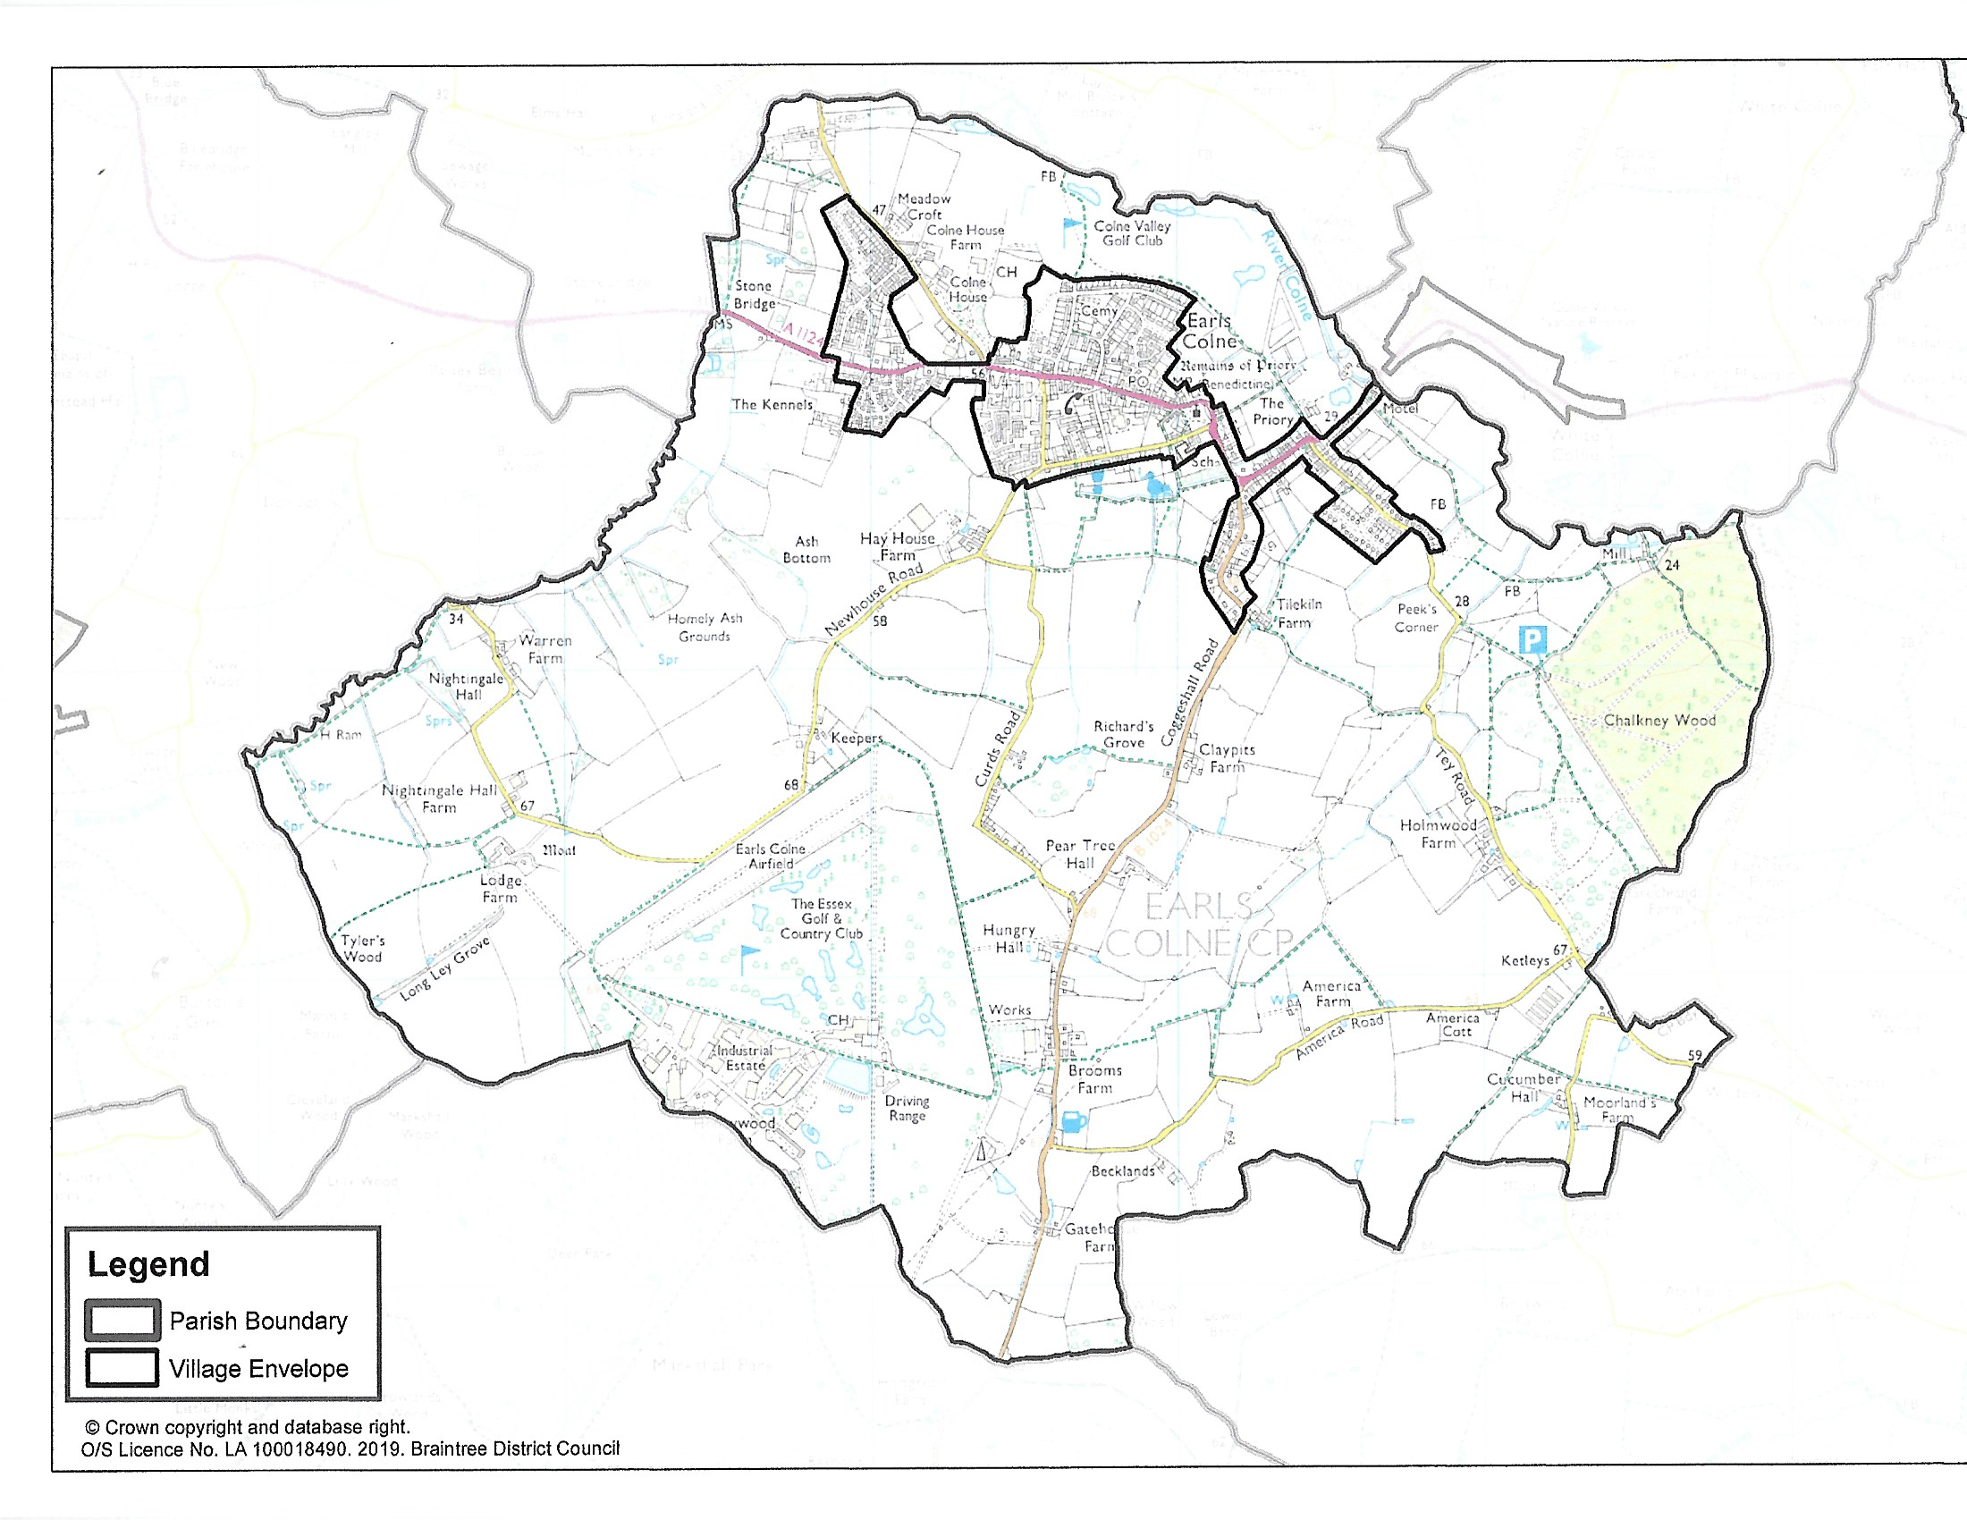
Parish Boundaries Plan ( As supplied by BDC)

Slide 7
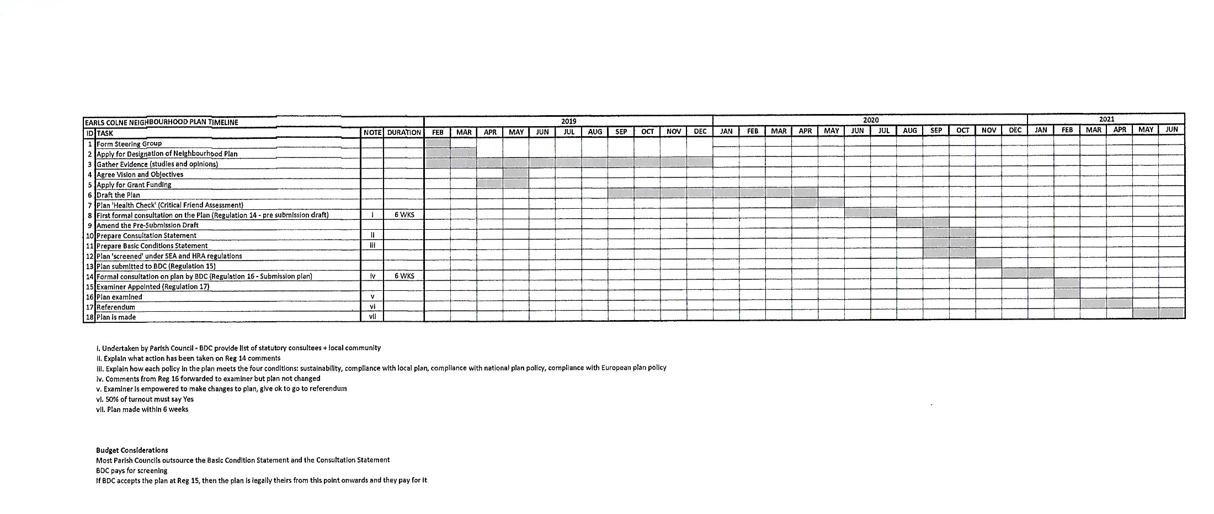
Neighbourhood Plan Project Programme (First Draft)
Completion Date June 2021

Slide 8
Neighbourhood Plan Task Group Meeting 26.02.19
Agenda
1. | Introduction | Tony Calton
2. | Progress so far on the Neighbourhood Plan | Tony Calton
3. | Overview of scope for each Task Group
 | Housing | Paul Copsey
 | Environment | Catherine Hayes
 | Economy | Denise Siddall
 | Community Facilities | Nikki Spelling
 | Infrastructure | Robert Cook
4. | Questions | All
5. | Break out sessions | All

